Slide 1
AAI for Apps
Using AAI with your Smartphone
Daniel Latzer
daniel.latzer@switch.ch
Zürich, April 2013

Slide 2
The Problem
Smartphone apps got very popular
Universities want to develop their own apps
No easy way to authenticate users in apps using AAI
Either user has to log in on every app start
Or the app stores the user credentials
App emulates browser and performs login

Slide 3
The Solution: Mobile Proxy
OAuth2 authentication server
Mobile Proxy requests one initial AAI Login per app
Creates OAuth2 Access token
Access token is used to
Authenticate with Mobile Proxy
Retrieve up-to-date AAI attributes from Mobile Proxy
Retrieve arbitrary protected resources from third party resource server
Access token is valid for an extended period of time
No need to log in every time you use the app
May be revoked using a separate web interface

Slide 4
OAuth2
Framework to log in to a service using third-party credentials
Exchanges user credentials for access tokens
Credentials do not need to be stored
Access tokens permissions can be limited to the necessary

Slide 5
Architecture
AAI Login
Mobile Proxy
AAI IdP
Access Token
Access Token
AAI Attributes
AAI Attributes
Verify Login
Access Token
Protected Data
Resource Server

Slide 6
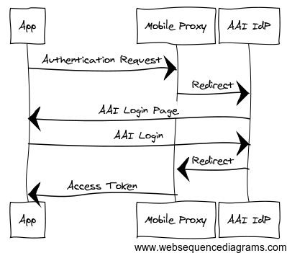
Login Flow
Notes:
Diagram Source:
App->Mobile Proxy: Authentication Request
Mobile Proxy->AAI IdP: Redirect
AAI IdP->App: AAI Login Page
App->AAI IdP: AAI Login
AAI IdP->Mobile Proxy: Redirect
Mobile Proxy->App: Access Token

Slide 7
Redirection from Browser To App
After the AAI login is complete, the IdP redirects back to the Mobile Proxy
The Mobile Proxy then displays a Page with a refresh header, pointing to a custom URL scheme:
uniapp://{app-name}/{access_token}
e.g. uniapp://demo/4yCjmdDlCtb8eWNNnmdrVKH1Kq1To0dVMLvu
The mobile app is designed to react to this URL scheme and is opened.
The access token is read out of the URL and stored in the app
Login complete

Slide 8
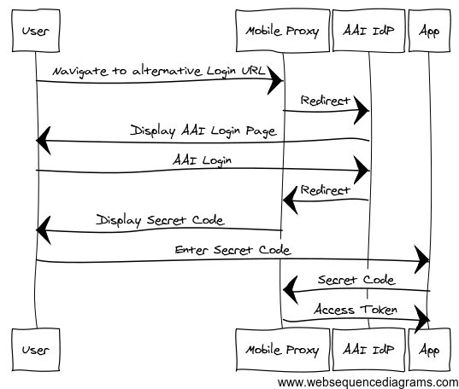
Desktop Login Flow
Notes:
User -> Mobile Proxy : Navigate to alternative Login URL
Mobile Proxy -> AAI IdP : Redirect
AAI IdP -> User : Display AAI Login Page
User -> AAI IdP : AAI Login
AAI IdP -> Mobile Proxy : Redirect
Mobile Proxy -> User : Display Secret Code
User -> App : Enter Secret Code
App -> Mobile Proxy : Secret Code
Mobile Proxy -> App : Access Token

Slide 9
AAI Attribute Query
All SWITCHaai IdPs support stored persistentIDs
PersistentID stored in database with mapping to user's attributes
Allows getting attributes for a user identified by persistentID
Attribute Query can be performed by SP without user interaction
Query can only succeed if user has accessed service at least once
How to make Attribute Queries
resolvertest binary can be used to make attribute queries
bundled with Shibboleth but slow
AttributeQuery Plugin for Shibboleth 2.5
Created by NII (GakuNin federation, JP)
Provides a handler to make fast Attribute Queries via web /Shibboleth.sso/AttributeQuery?nameID=....&entityID=....

Slide 10
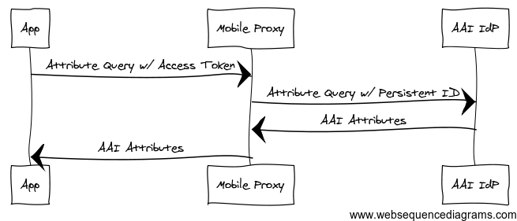
Attribute Retrieval
Notes:
Diagram Source:
App->Mobile Proxy: Attribute Query w/ Access Token
Mobile Proxy->AAI IdP: Attribute Query w/ Persistent ID
AAI IdP->Mobile Proxy: AAI Attributes
Mobile Proxy->App: AAI Attributes

Slide 11
Mobile Proxy Overview
Features
Lightweight OAuth2 Server to map an AAI Persistent-ID to an access token
Provides REST/JSON interface
Web interface for revoking access to specific tokens
Supports multiple Apps with different attribute requirements
Requirements
PHP 5.3
MySQL
Shibboleth 2.5

Slide 12
Example App Overview
Sample application that can be used as basis for own App
Features
2 login methods
Via integrated mobile phone web browser
Via a PC to support alternative login mechanisms like X.509
Requires user to type a URL and a code or use QR code
Retrieves up-to-date attributes from IdP via Mobile Proxy
Retrieves application-specific data from a resource server
Requirements
Android 2.2+

Slide 13
Availability
Mobile Proxy and App were created as proof-of-concept
BSD License
Webpage and additional information https://www.switch.ch/aai/support/tools/aai-for-apps.html

